Slide 1
CRYPTOGRAPHY
Classical Cryptography

Slide 2
Classical Cryptosystems (Monoalphabetic)

Slide 3
Cryptosystem
A cryptosystem is a five-tuple (P, C, K, E, D), where following
conditions are satisfied :
  P is a finite set of possible plaintexts
  C is a finite set of possible ciphertexts
  K, the keyspace, is a finite set of possible keys
  For each K ∈ K, there is an encryption algorithm E_{K} ∈ E and a corresponding decryption algorithm D_{K} ∈ D. Each E_{K} : P → C and D_{K} : C → P are functions such that D_{K}(E_{K}(X)) = X for every plaintext X ∈ P.

Slide 4
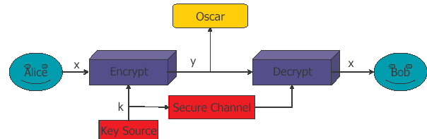
Simple Cryptosystems

Slide 5
Monoalphabetic Ciphers
The ciphers for which, once a key is chosen, each alphabetic character is mapped to a unique alphabetic character
Examples of monoalphabetic ciphers include Shift cipher, Substitution Cipher and Affine cipher

Slide 6
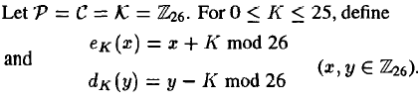
1. Shift Cipher
Let plaintext (p) = wewillmeetatmidnight
We first convert the plaintext string into integers. The rule is:
a<->0, b<->1, c<->2, d<->3, e<->4, f<->5, g<->6, h<->7, i<->8, j<->9, k<->10, l<->11, m<->12,n<->13, o<->14, p<->15,q<->16, r<->17, s<->18, t<->19, u<->20, v<->21, w<->22, x<->23, y<->24, z<->25
w | e | w | i | l | l | m | e | e | t | a | t | m | i | d | n | i | g | h | t
22 | 4 | 22 | 8 | 11 | 11 | 12 | 4 | 4 | 19 | 0 | 19 | 12 | 8 | 3 | 13 | 8 | 6 | 7 | 19
Let K=11, we add 11 to each value, reducing each sum modulo 26, we get ciphertext
7 | 15 | 7 | 19 | 22 | 22 | 23 | 15 | 15 | 4 | 11 | 4 | 23 | 19 | 14 | 24 | 19 | 17 | 18 | 4
H | P | T | T | W | W | X | P | P | E | L | E | X | T | O | Y | T | R | S | E

Slide 7
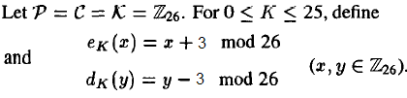
1. Shift Cipher
For a particular Key k=3, the cryptosystem is often called the
Caesar Cipher (Roman Empire, 2000 years ago )
  0123456...
  Plain: abcdefghijklmnopqrstuvwxyz
  Cipher: DEFGHIJKLMNOPQRSTUVWXYZABC
  3456789...
  Plain: meet me after the toga party
  Cipher: PHHW PH DIWHU WKH WRJD SDUWB

Slide 8
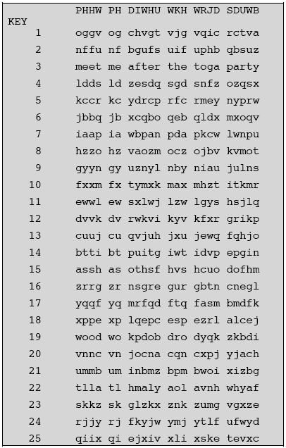
Cryptanalysis of Shift Cipher
Shift cipher (modulo 26) is not secure, since it can be cryptanalyzed by brute force attack
There are only 25 keys to try, until a meaningful plaintext string is obtained
On average, a plaintext will be computed using 26/2=13 decryption rules
  - Plain: meet me after the toga party
  Cipher: PHHW PH DIWHU WKH WRJD SDUWB

Slide 9
Example
Cipher Text is
Guvf vf n frperg zrffntr.

Slide 10
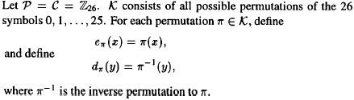
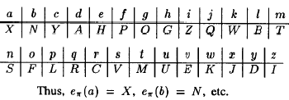
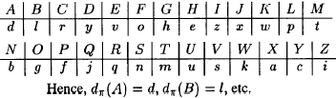
2. The Substitution Cipher
Example:
Plaintex: s u b s t i t u t i o n
Ciphertext:V U N V M Z M U M Z F S

Slide 11
2. Cryptanalysis of The Substitution Cipher
A key in substitution cipher consist of a permutation of 26 alphabetic characters
There are 26! = ~4 x 10²⁶ possible keys
Exhaustive key search is infeasible
Simple substitution ciphers were considered strong for many centuries
The first ever published description of how to crack simple substitution ciphers was given by Arab/Iraqi scientist Abu Yusuf Yaqub ibn Ishaq al-Kindi in A Manuscript on Deciphering Cryptographic Messages written around 850 CE
The method he described is now known as Frequency Analysis

Slide 12
2. Frequency Analysis
The statistical distribution of letter frequencies of a message (text) written in any language tend towards a known letter frequency distribution profile of the language
This is particularly true for long messages (i.e., the longer the text, the closer the letter frequency distributions match the language’s letter frequency distributions)
The simple substitution cipher preserves the letter frequency distributions of the plaintext in the ciphertext (i.e., information about the plaintext is leaked in the ciphertext)
The attacker takes a frequency count of the ciphertext letters and tries to match them to the letter frequency distribution profile of the plaintext language

Slide 13
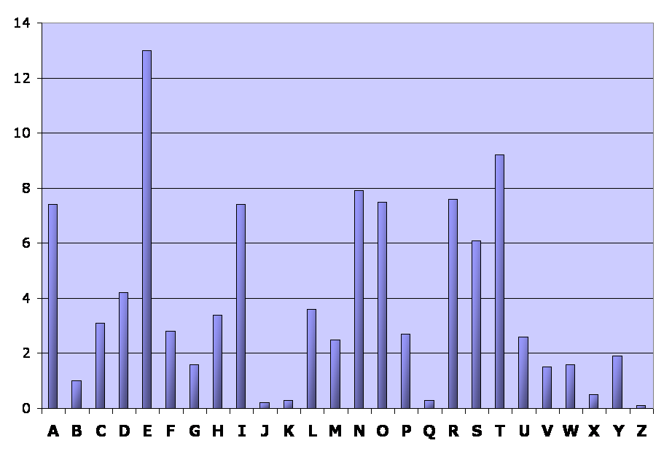
English language:
Relative letter frequencies
Letter | A | B | C | D | E | F | G | H | I | J | K | L | M
Frequency | 7.4 | 1.0 | 3.1 | 4.2 | 13.0 | 2.8 | 1.6 | 3.4 | 7.4 | 0.2 | 0.3 | 3.6 | 2.5
Letter | N | O | P | Q | R | S | T | U | V | W | X | Y | Z
Frequency | 7.9 | 8.0 | 2.7 | 0.3 | 8.0 | 6.1 | 9.2 | 2.6 | 1.5 | 1.6 | 0.5 | 1.9 | 0.1

Slide 14
English language:
Relative letter frequencies
Ciphertext:
R jrk hbxiu lk vai vzihova ohlls lo rk rmrsvjikv ywbhtbkn. Ixise jlskbkn ai vrgiu vai ihixrvls tlzk vl vai hlyye rkt hirxiu vai ywbhtbkn. Bk vai ixikbkn, ai nivu bkvl vai ihixrvls, rkt, bo vaisi bu uljilki ihui bk vai ihixrvls -- ls bo bv zru srbkbkn varv tre -- ai nliu yrpg vl abu ohlls tbsipvhe. Alzixis, bo vaisi bu klylte ihui bk vai ihixrvls rkt bv aruk'v srbkit, ai nliu vl vai vikva ohlls rkt zrhgu wm vzl ohbnavu lo uvrbsu vl abu sllj.
Letter frequency count (total = 344 letters):
Letter | A | B | C | D | E | F | G | H | I | J | K | L | M
Frequency | 23 | 26 | 0 | 0 | 5 | 0 | 3 | 18 | 49 | 5 | 26 | 32 | 2
Letter | N | O | P | Q | R | S | T | U | V | W | X | Y | Z
Frequency | 9 | 10 | 2 | 0 | 24 | 19 | 11 | 19 | 37 | 3 | 9 | 6 | 6

Slide 15
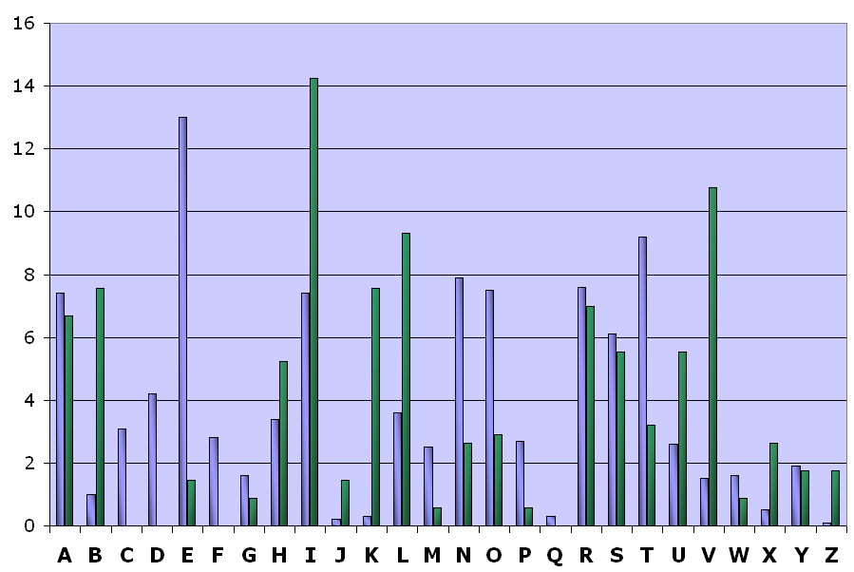
Relative frequency distributions
(English & ciphertext)

Slide 16
Example: Frequency analysis
From the frequency distributions, we assume that:
  The ciphertext letter I corresponds to the plaintext letter E (the most frequent letter in the English language)
  The ciphertext letter V corresponds to the plaintext letter T (the second most frequent letter in the English language)
Partially decrypted ciphertext (red = plaintext):
R jrk hbxeu lk vae vzehova ohlls lo rk rmrsvjekv ywbhtbkn. Exese jlskbkn ae vrgeu vae ehexrvls tlzk vl vae hlyye rkt herxeu vae ywbhtbkn. Bk vae exekbkn, ae nevu bkvl vae ehexrvls, rkt, bo vaese bu uljelke ehue bk vae ehexrvls -- ls bo bv zru srbkbkn varv tre -- ae nleu yrpg vl abu ohlls tbsepvhe. Alzexes, bo vaese bu klylte ehue bk vae ehexrvls rkt bv aruk'v srbket, ae nleu vl vae vekva ohlls rkt zrhgu wm vzl ohbnavu lo uvrbsu vl abu sllj.

Slide 17
Example: Frequency analysis
From the frequency distributions, we assume that:
  The ciphertext letter I corresponds to the plaintext letter E (the most frequent letter in the English language)
  The ciphertext letter V corresponds to the plaintext letter T (the second most frequent letter in the English language)
Partially decrypted ciphertext (red = plaintext):
R jrk hbxeu lk tae tzehota ohlls lo rk rmrstjekt ywbhtbkn. Exese jlskbkn ae trgeu tae ehexrtls tlzk tl tae hlyye rkt herxeu tae ywbhtbkn. Bk tae exekbkn, ae netu bktl tae ehexrtls, rkt, bo taese bu uljelke ehue bk tae ehexrtls -- ls bo bt zru srbkbkn tart tre -- ae nleu yrpg tl abu ohlls tbsepthe. Alzexes, bo taese bu klylte ehue bk tae ehexrtls rkt bt aruk't srbket, ae nleu tl tae tekta ohlls rkt zrhgu wm tzl ohbnatu lo utrbsu tl abu sllj.

Slide 18
Example: Frequency analysis
From the frequency distributions, we assume that:
We can assume that the ciphertext letter A corresponds to the plaintext letter H because:
  The digram ‘TH’ is the most common in the English language
  The word “THE” is the only frequently used 3-letter English word starting with T and ending with E
Partially decrypted ciphertext (red = plaintext):
R jrk hbxeu lk the tzehoth ohlls lo rk rmrstjekt ywbhtbkn. Exese jlskbkn he trgeu the ehexrtls tlzk tl the hlyye rkt herxeu the ywbhtbkn. Bk the exekbkn, he netu bktl the ehexrtls, rkt, bo these bu uljelke ehue bk the ehexrtls -- ls bo bt zru srbkbkn thrt tre -- he nleu yrpg tl hbu ohlls tbsepthe. hlzexes, bo these bu klylte ehue bk the ehexrtls rkt bt hruk't srbket, he nleu tl the tekth ohlls rkt zrhgu wm tzl ohbnhtu lo utrbsu tl hbu sllj.

Slide 19
Example: Frequency analysis
We can assume that the ciphertext letter R corresponds to the plaintext letter A because:
  The word “THAT” is the only frequently used 4-letter English word starting with ‘TH’ and ending with T
  The relative frequency of R in the ciphertext closely approximates the relative frequency of A in English
Partially decrypted ciphertext (red = plaintext):
A jak hbxeu lk the tzehoth ohlls lo ak amastjekt ywbhtbkn. Exese jlskbkn he tageu the ehexatls tlzk tl the hlyye akt heaxeu the ywbhtbkn. Bk the exekbkn, he netu bktl the ehexatls, akt, bo these bu uljelke ehue bk the ehexatls -- ls bo bt zau sabkbkn that tae -- he nleu yapg tl hbu ohlls tbsepthe. hlzexes, bo these bu klylte ehue bk the ehexatls akt bt hauk't sabket, he nleu tl the tekth ohlls akt zahgu wm tzl ohbnhtu lo utabsu tl hbu sllj.

Slide 20
Example: Frequency analysis
We can assume that the ciphertext letter K corresponds to the plaintext letter N because:
  The words “AN” and “AT” are the only frequently used 2-letter English words starting with A
  The relative frequency of K in the ciphertext closely approximates the relative frequency of N in English
Partially decrypted ciphertext (red = plaintext):
A jan hbxeu ln the tzehoth ohlls lo an amastjent ywbhtbnn. Exese jlsnbnn he tageu the ehexatls tlzn tl the hlyye ant heaxeu the ywbhtbnn. Bn the exenbnn, he netu bntl the ehexatls, ant, bo these bu uljelne ehue bn the ehexatls -- ls bo bt zau sabnbnn that tae -- he nleu yapg tl hbu ohlls tbsepthe. hlzexes, bo these bu nlylte ehue bn the ehexatls ant bt haun't sabnet, he nleu tl the tenth ohlls ant zahgu wm tzl ohbnhtu lo utabsu tl hbu sllj.

Slide 21
Example: Frequency analysis
We assume that:
  The ciphertext letter T corresponds to the plaintext letter D (from the word ‘ant’)
  The ciphertext letter B corresponds to the plaintext letter I (from the words ‘bt’ and ‘bn’)
Partially decrypted ciphertext (red = plaintext):
A jan hbxeu ln the tzehoth ohlls lo an amastjent ywbhtbnn. Exese jlsnbnn he tageu the ehexatls tlzn tl the hlyye ant heaxeu the ywbhtbnn. Bn the exenbnn, he netu bntl the ehexatls, ant, bo these bu uljelne ehue bn the ehexatls -- ls bo bt zau sabnbnn that tae -- he nleu yapg tl hbu ohlls tbsepthe. hlzexes, bo these bu nlylte ehue bn the ehexatls ant bt haun't sabnet, he nleu tl the tenth ohlls ant zahgu wm tzl ohbnhtu lo utabsu tl hbu sllj.

Slide 22
Example: Frequency analysis
We assume that:
  The ciphertext letter T corresponds to the plaintext letter D (from the word ‘ant’)
  The ciphertext letter B corresponds to the plaintext letter I (from the words ‘bt’ and ‘bn’)
Partially decrypted ciphertext (red = plaintext):
A jan hixeu ln the tzehoth ohlls lo an amastjent ywihtinn. Exese jlsninn he tageu the ehexatls tlzn tl the hlyye ant heaxeu the ywihtinn. in the exeninn, he netu intl the ehexatls, ant, io these iu uljelne ehue in the ehexatls -- ls io it zau saininn that tae -- he nleu yapg tl hiu ohlls tisepthe. hlzexes, io these iu nlylte ehue in the ehexatls ant it haun't sainet, he nleu tl the tenth ohlls ant zahgu wm tzl ohinhtu lo utaisu tl hiu sllj.

Slide 23
Example: Frequency analysis
If you continue like this, completing words (using your knowledge of the English language) and matching ciphertext letters with probable plaintext letters (using the relative frequencies), you will eventually obtain a complete decryption of the message and will also have recovered the key (the substitution alphabet)
The substitution alphabet for this example is:
  p : ABCDEFGHIJKLMNOPQRSTUVWXYZ
  F_{k}(p) : RYPTIONABFGHJKLMQSUVWXZDEC

Slide 24
Other English language features
Digram frequencies
  Common digraphs: EN, RE, ER, NT, TH
Trigram frequencies
  Common trigrams: THE, ING, THA, ENT
Vowels other than E are rarely followed by another vowel
The letter Q is followed only by U

Slide 25
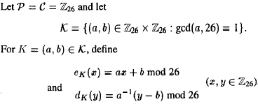
3. The Affine Cipher
Suppose K=(7,3), We can calculate 7-1 mod 26=15, the encryption formula becomes:
e_{K} (x)=7*x + 3 mod 26
And the corresponding decryption function id
d_{k}(y)= 15 (y-3) = 15 y - 19
Example: Encrypt “ hot” ⬄ 7, 14, 19
(7 x 7 + 3) mod 26 = 52 mod 26 = 0
7x14 + 3) mod 26 =101 mod 26=23
(7x19 + 3) mod 26 -= 136 mod 26=6
0,23,6 ⬄ AXG

Slide 26
Finding Inverses
Example: Find an inverse of 101 modulo 4620.
Solution: First use the Euclidian algorithm to show that gcd(101,4620) = 1.
Working Backwards:
  42620 = 45∙101 + 75
  101 = 1∙75 + 26
  75 = 2∙26 + 23
  26 = 1∙23 + 3
  23 = 7∙3 + 2
  3 = 1∙2 + 1
  2 = 2∙1
  1 = 3 − 1∙2
  1 = 3 − 1∙(23 − 7∙3) = − 1 ∙23 + 8∙3
  1 = −1∙23 + 8∙(26 − 1∙23) = 8∙26 − 9 ∙23
  1 = 8∙26 − 9 ∙(75 − 2∙26 )= 26∙26 − 9 ∙75
  1 = 26∙(101 − 1∙75) − 9 ∙75
  = 26∙101 − 35 ∙75
  1 = 26∙101 − 35 ∙(42620 − 45∙101)
  = − 35 ∙42620 + 1601∙101
Since the last nonzero
remainder is 1,
gcd(101,4260) = 1
Bézout coefficients : − 35 and 1601
1601 is an inverse of 101 modulo 42620

Slide 27
Cryptanalysis of the Affine Cipher (1)
Consider the Cipher-text:
Frequency occurrences of each letter
R | D | E,H,K | F,V | P,S | A,L,M,U,X | B,N,O,Y | C,G,I,J,Q,T,W,Z
8 | 6 | 5 | 4 | 3 | 2 | 1 | 0
57
Hypothesis 1
R is encryption of e
D is encryption of t
e_{K}(4) = 17
e_{K}(19) = 3
Recall that , e_{k}(x)=a*x + b, thus
4a + b=17
19a + b=3
a=6 in Z₂₆
B=19
gcd(a,m)=gcd(6,26)=2>1
iIlegal key
Cont…….

Slide 28
Cryptanalysis of the Affine Cipher (2)
Consider the Cipher-text:
Frequency occurrence of each letter
R | D | E,H,K | F,V | P,S | A,L,M,U,X | B,N,O,Y | C,G,I,J,Q,T,W,Z
8 | 6 | 5 | 4 | 3 | 2 | 1 | 0
57
Hypothesis 2
R is encryption of e
E is encryption of t
e_{K}(4) = 17
e_{K}(19) = 4
Recall that , e_{k}(x)=a*x + b, thus
4a + b=17
19a + b=4
a=13 in Z₂₆
b=17
gcd(a,m)=gcd(13,26)=13>1
iIlegal key

Slide 29
Cryptanalysis of the Affine Cipher (3)
Consider the Cipher-text:
Frequency occurrence of each letter
R | D | E,H,K | F,V | P,S | A,L,M,U,X | B,N,O,Y | C,G,I,J,Q,T,W,Z
8 | 6 | 5 | 4 | 3 | 2 | 1 | 0
57
Hypothesis 3
R is encryption of e
H is encryption of t
e_{K}(4) = 17
e_{K}(19) = 7
Recall that , e_{k}(x)=a*x + b, thus
4a + b=17
19a + b=7
a=8 in Z₂₆
b=11
gcd(a,m)=gcd(8,26)=2>1
iIlegal key

Slide 30
Cryptanalysis of the Affine Cipher (4)
Consider the Cipher-text:
Frequency occurrence of each letter
R | D | E,H,K | F,V | P,S | A,L,M,U,X | B,N,O,Y | C,G,I,J,Q,T,W,Z
8 | 6 | 5 | 4 | 3 | 2 | 1 | 0
57
Hypothesis 4
R is encryption of e
K is encryption of t
e_{K}(4) = 17
e_{K}(19) = 10
4a + b=17
19a + b=10
a=3 in Z₂₆
b=5
gcd(a,m)=gcd(3,26)=1
Looks a legal key
Key=K(3,5)
Verify
3⁻¹ mod 26=9
The decryption function
d_{k}(y)=9*y - 9
The ciphertext is:
Algorithmsarequitegeneraldefinitionsofarithmeticprocesses

Slide 31
Practice Session (Substitution Cipher)
GFS WMY OG LGDVS MF SFNKYHOSU ESLLMRS, PC WS BFGW POL DMFRQMRS, PL OG CPFU M UPCCSKSFO HDMPFOSXO GC OIS LMES DMFRQMRS DGFR SFGQRI OG CPDD GFS LISSO GK LG, MFU OISF WS NGQFO OIS GNNQKKSFNSL GC SMNI DSOOSK. WS NMDD OIS EGLO CKSJQSFODY GNNQKKPFR DSOOSK OIS 'CPKLO', OIS FSXO EGLO GNNQKKPFR DSOOSK OIS 'LSNGFU' OIS CGDDGWPFR EGLO GNNQKKPFR DSOOSK OIS 'OIPKU', MFU LG GF, QFOPD WS MNNGQFO CGK MDD OIS UPCCSKSFO DSOOSKL PF OIS HDMPFOSXO LMEHDS. OISF WS DGGB MO OIS NPHISK OSXO WS WMFO OG LGDVS MFU WS MDLG NDMLLPCY POL LYEAGDL. WS CPFU OIS EGLO GNNQKKPFR LYEAGD MFU NIMFRS PO OG OIS CGKE GC OIS 'CPKLO' DSOOSK GC OIS HDMPFOSXO LMEHDS, OIS FSXO EGLO NGEEGF LYEAGD PL NIMFRSU OG OIS CGKE GC OIS 'LSNGFU' DSOOSK, MFU OIS CGDDGWPFR EGLO NGEEGF LYEAGD PL NIMFRSU OG OIS CGKE GC OIS 'OIPKU' DSOOSK, MFU LG GF, QFOPD WS MNNGQFO CGK MDD LYEAGDL GC OIS NKYHOGRKME WS WMFO OG LGDVS.

Slide 32
Practice Session (Substitution Cipher)
one way to solve an encrypted message, if we know its language, is to find a different plaintext of the same language long enough to fill one sheet or so, and then we count the occurrences of each letter. we call the most frequently occurring letter the 'first', the next most occurring letter the 'second' the following most occurring letter the 'third', and so on, until we account for all the different letters in the plaintext sample. then we look at the cipher text we want to solve and we also classify its symbols. we find the most occurring symbol and change it to the form of the 'first' letter of the plaintext sample, the next most common symbol is changed to the form of the 'second' letter, and the following most common symbol is changed to the form of the 'third' letter, and so on, until we account for all symbols of the cryptogram we want to solve.

